Slide 1
Motion Graph Analysis P-T, V-T, and A-T Graphs

Slide 2
Graph Relationships

Slide 3
PT to VT Graphs (Recap) (Position-Time to Velocity-Time)
Uniform Motion: v = constant, a = 0
Non-uniform Motion: v = changing, a <> 0
Position-Time
Velocity-Time
Slope of Line
=
Average Velocity
Position-Time
Velocity-Time
Slope of Tangent
=
Instantaneous Velocity

Slide 4
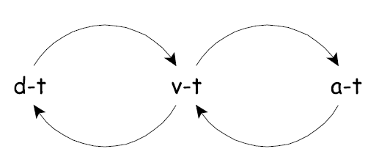
PT and VT Graphs
Position-Time
Velocity-Time
Slope of Line
=
Average Velocity
Velocity-Time
Area under line
=
Displacement
Position-Time
Slope
Area

Slide 5
V-T and A-T Graphs
Velocity-Time
Slope of line
=
Acceleration
Acceleration-Time
Acceleration-Time
Area under line
=
Change in Velocity
Velocity-Time
Slope
Slope
Area
Area

Slide 6
VT to AT Graphs (Special Cases)
Uniform Motion: v = constant, a = 0
Non-uniform Motion: v = changing, a <> 0
Velocity-Time
Acceleration-Time
Slope of Line
=
Acceleration
Velocity-Time
Acceleration-Time
Slope of Line
=
Acceleration

Slide 7
Using P-T graphs to find acceleration

Slide 8

PT to VT Graphs (Tangent & Slope)
30
20
Position (m [E])
2
Velocity (m /s [E])
10
1
0
0
4
8
12
4
8
12
Time (s)
Time (s)

Slide 9
PT to VT Graphs (Tangent & Slope)
30
20
Position (m [E])
Velocity (m /s [E])
2
10
1
0
0
4
8
12
4
8
12
Time (s)
Time (s)
Slope of V-T Graph is the Acceleration

Slide 10
PT to VT Graphs (Instantaneous Velocity)
30
20
Position (m [E])
Velocity (m /s [E])
2
10
1
0
0
4
8
12
4
8
12
Time (s)
Time (s)
Instantaneous Velocity is the velocity at a
specific point in time.

Slide 11
Instantaneous Velocity (Uniform & Accelerated Motion)

Slide 12
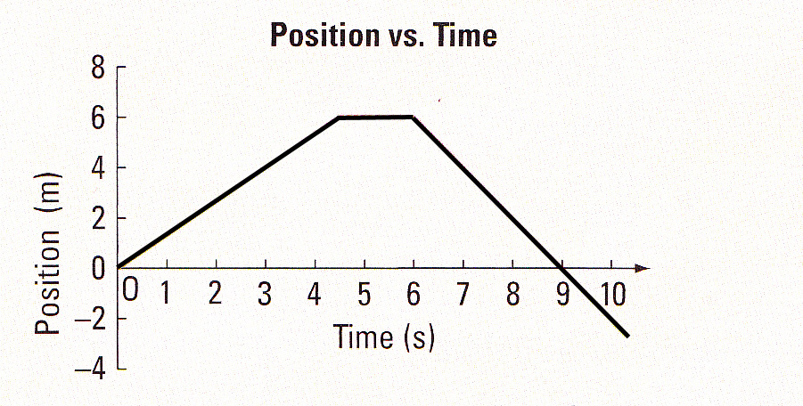
Instantaneous Velocity (Uniform Motion)
B
A
C
Examine Each Straight Line Segment
Slope of the segment is the Instantaneous Velocity for the segment
Total Displacement / Total Time give the Average Velocity

Slide 13
Instantaneous Velocity (Accelerated Motion)
30
20
Position (m [E])
2
Velocity (m /s [E])
10
1
0
0
4
8
12
4
8
12
Time (s)
Time (s)
Use Tangent Line & Slope
For a specific point in time (e.g. t = 4s)
Slope m = 1 so Velocity = 1 m/s at t=4s
Note: Line, Slope, and Velocity will be different for other times

Slide 14
Using V-T graphs to find Displacement

Slide 15
Position-Time from Velocity-Time
We can use the area under a velocity-time to find displacement!
For uniform motion:
area = base x height
d = Δt x v
therefore: d= area
check units: (s) x (m/s) = m
Velocity-Time
area = b x h

Slide 16
Example: Uniform Motion (t=0s)
3
30
2
20
Velocity (m/s [Up])
Position (m [Up])
t = 0s
1
10
0
0
0
4
8
12
0
4
8
12
Time (s)
Time (s)
area = b x h = 0 x 2 = 0
position = Δt x v = 0 s x 2 m/s [Up] = 0 m [Up]

Slide 17
Example: Uniform Motion (t=4s)
3
30
2
20
Velocity (m/s [Up])
Position (m [Up])
t = 4s
1
10
0
0
0
4
8
12
0
4
8
12
Time (s)
Time (s)
area = b x h = 4 x 2 = 8
position = Δt x v = 4 s x 2 m/s [Up] = 8 m [Up]

Slide 18
Example: Uniform Motion (t=8s)
3
30
2
20
Velocity (m/s [Up])
Position (m [Up])
t = 8s
1
10
0
0
0
4
8
12
0
4
8
12
Time (s)
Time (s)
area = b x h = 8 x 2 = 16
position = Δt x v = 8 s x 2 m/s [Up] = 16 m [Up]

Slide 19
Example: Uniform Motion (t=12s)
3
30
2
20
Velocity (m/s [Up])
Position (m [Up])
t = 12s
1
10
0
0
0
4
8
12
0
4
8
12
Time (s)
Time (s)
area = b x h = 12 x 2 = 24
position = Δt x v = 12 s x 2 m/s [Up] = 24 m [Up]

Slide 20
Your Turn
Determine the Position-Time graph from the following Velocity-Time graph
Hint: Think Triangles
14
10
Velocity (m/s [Up])
5
0
0
4
8
12
Time (s)

